Slide 1
Software Quality Assurance
Dr. Seemab Latif
Lecture No. 4
24th February, 2011

Slide 2
Review of Previous Lecture
Black box testing is a strategy in which testing is based solely on the requirements and specifications.
It requires no knowledge of the internal paths, structure, or implementation of the software under test (SUT).
It can be applied to all levels of testing.
White box testing is a strategy in which testing is based on the internal paths, structure, and implementation of the software under test (SUT).
It generally requires detailed programming skills.
White box testing is more than code testing-it is path testing.

Slide 3
Techniques of Black Box Testing
Equivalence Class Testing
Boundary Value Testing
Decision Table Testing
Pair-wise Testing
State-Transition Testing

Slide 4
Equivalence Class Testing
Group input and outputs of a component into classes which can be treated similarly
Assumed to be treated equally by component
A value in a partition is taken to be representative all the entire partition
If the test passes for the representative value it is assumed that all other values in the group will also pass

Slide 5
Example Partitions
Values between boundaries
Numeric values <0, =0, >0
Dates <2000, =2000, >2000; leap/non-leap years
Months of various lengths
0–16 Don't hire
16–18 Can hire on a part-time basis only
18–55 Can hire as a full-time employee
55–99 Don't hire
Objects with different state
Empty/non-empty strings/lists/containers
Files with different permissions
Objects/references which exist/don’t exist
Valid vs invalid input and output values

Slide 6
Design of Test Cases
Test cases must exercise all partitions
Each test case lists
Inputs
Partition(s) to be exercised
Expected outcome of the test case
Two approaches
Separate test cases for each partition
Minimal set of test cases to cover all partitions

Slide 7
One-to-one versus Minimalist
One-to-one
More time consuming as many more cases
More detail in the case of test failure
Minimalist
Less time consuming to prepare cases
Less detail on failure
Testing still effective
May be hard to determine cause of failure
Makes debugging more difficult

Slide 8
Equivalence Class Testing:Key Point
A group of tests forms an equivalence class if:
They all test the same thing.
If one test catches a bug, the others probably will too.
If one test doesn't catch a bug, the others probably won't either.

Slide 9
Boundary Value Testing
Tests around edges of partitions
Multiple tests per partition on boundaries
Retains assuming that similar values (values from the same partition) are treated similarly
Catches developer errors in choosing boundary values and conditions
Boundary value testing focuses on the boundaries because that is where so many defects hide.

Slide 10
Example Boundaries
The limits of the equivalence classes
Zero
Monday/Sunday, December/January
MININT/MAXINT, MINFLOAT/MAXFLOAT
Wrap-around values: min/max, ’99 vs ’00
Zero, one, multi-element strings/sequences

Slide 11
Boundary Value Tests
Test on and next to boundaries
Move value by smallest possible value
±1 for ints, ± single char for strings, ±ε for doubles
Non-scalar values only have =/≠
Boundaries may be open/closed
Complete vs minimal testing
x <= 5 x >= 10

Slide 12
Boundary Matrices
Vary values/conditions around one boundary
Test boundary
Hold other values/conditions at typical values
Choose values from equivalence class

Slide 13
Decision Table Testing
Decision tables represent complex business rules based on a set of conditions
Decision Table testing can be used whenever the system must implement complex business rules when these rules can be represented as a combination of conditions and when these conditions have discrete actions associated with them.

Slide 14
Example Decision Table
 | Rule-1 | Rule-2 | ------- | Rule-p
Conditions
condition -1
condition -2
-------
condition-m
Actions
action-1
action-2
-------
action-n

Slide 15
Pair-wise Testing
Pair-wise (a.k.a. all-pairs) testing is an effective test case generation technique that is based on the observation that most faults are caused by interactions of at most two factors.
Pair-wise generated test suites cover all combinations of two therefore are much smaller than exhaustive ones yet still very effective in finding defects.
Pari-wise Testing--Combinatorial Test Case Generation

Slide 16
Pair-wise Testing: Example
Consider these situations:
A Web site must operate correctly with different browsers—Internet Explorer 5.0, 5.5, and 6.0, Netscape 6.0, 6.1, and 7.0, Mozilla 1.1, and Opera 7; using different plug-ins—RealPlayer, Media Player, or none; running on different client operating systems—Windows 95, 98, ME, NT, 2000, and XP; receiving pages from different servers—IIS, Apache, and WebLogic; running on different server operating systems—Windows NT, 2000, and Linux.
Web Combinations
8 browsers
3 plug-ins
6 client operating systems
3 servers
3 server OS
1,296 combinations.

Slide 17
Pair-wise Testing: Example
It has a large number of combinations that may be risky if we do not test. It has such a large number of combinations that we may not have the resources to construct and run all the tests. We must select a reasonably sized subset that we could test given our resource constraints. What are some ways of choosing such a subset? This list starts with the worst schemes but does improve:
Don't test at all. Simply give up because the number of input combinations, and thus the number of test cases, is just too great.
Test all combinations [once], but delay the project so it misses its market window so that everyone quits from stress, or the company goes out of business.
Choose one or two tests and hope for the best.
Choose the tests that you have already run, perhaps as part of programmer-led testing. Incorporate them into a formal test plan and run them again.
Choose the tests that are easy to create and run. Ignore whether they provide useful information about the quality of the product.
Make a list of all the combinations and choose the first few.
Make a list of all the combinations and choose a random subset.
Best---By magic, choose a specially selected, fairly small subset that finds a great many defects—more than you would expect from such a subset.

Slide 18
Technique
Two different techniques are used to identify all the pairs for creating test cases
Orthogonal arrays
Allpairs algorithm

Slide 19
Using Orthogonal Arrays
The process of using orthogonal arrays to select pairwise subsets for testing is:
Identify the variables.
Determine the number of choices for each variable.
Locate an orthogonal array which has a column for each variable and values within the columns that correspond to the choices for each variable.
Map the test problem onto the orthogonal array.
Construct the test cases.

Slide 20
State-Transition Diagrams
Like decision tables, are another excellent tool to capture certain types of system requirements and to document internal system design.
These diagrams document the events that come into and are processed by a system as well as the system's responses.
When a system must remember something about what has happened before or when valid and invalid orders of operations exist, state-transition diagrams are excellent tools to record this information.

Slide 21
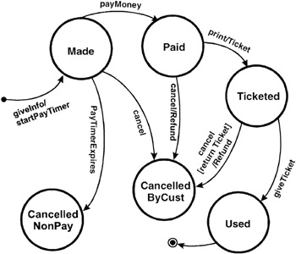
Example State Transition Diagram

Slide 22
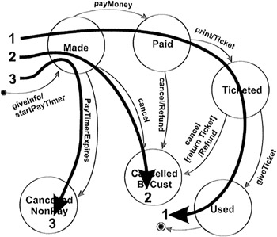
Creating Test Cases-Level 1
Create a set of test cases such that all states are "visited" at least once under test.

Slide 23

Level 2
Create a set of test cases such that all events are triggered at least once under test. Note that the test cases that cover each event can be the same as those that cover each state.

Slide 24
Level 3
Create a set of test cases such that all paths are executed at least once under test. While this level is the most preferred because of its level of coverage, it may not be feasible. If the state-transition diagram has loops, then the number of possible paths may be infinite. For example, given a system with two states, A and B, where A transitions to B and B transitions to A. A few of the possible paths are:
A→B
A→B→A
A→B→A→B→A→B
A→B→A→B→A→B→A
A→B→A→B→A→B→A→B→A→B
Testing of loops such as this can be important if they may result in accumulating computational errors or resource loss (locks without corresponding releases, memory leaks, etc.)

Slide 25
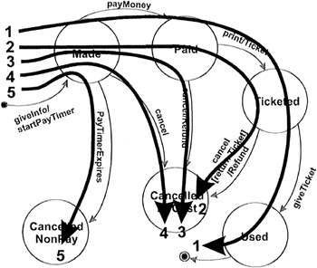
Level 4
Create a set of test cases such that all transitions are exercised at least once under test. This level of testing provides a good level of coverage without generating large numbers of tests. This level is generally the one recommended.

Slide 26
Summary
Black Box testing techniques:
Equivalence Class Testing: Group input and outputs of a component into classes which can be treated similarly
Boundary Value Testing: Tests around edges of partitions
Decision Table Testing: handles complex business rules which are based on a set of conditions
State-Transition Testing: document the events that come into and are processed by a system as well as the system's responses.

